Slide 1



About Us
Delay Analysis of URLLC in 5G Based on Stochastic Network Calculus
Shengcheng Ma
BISTU
20181204

Slide 2
Table of Contents
Outline of my presentation
Introduction
Related Work
System Model
Performance Evaluation
Conclusion

Slide 3
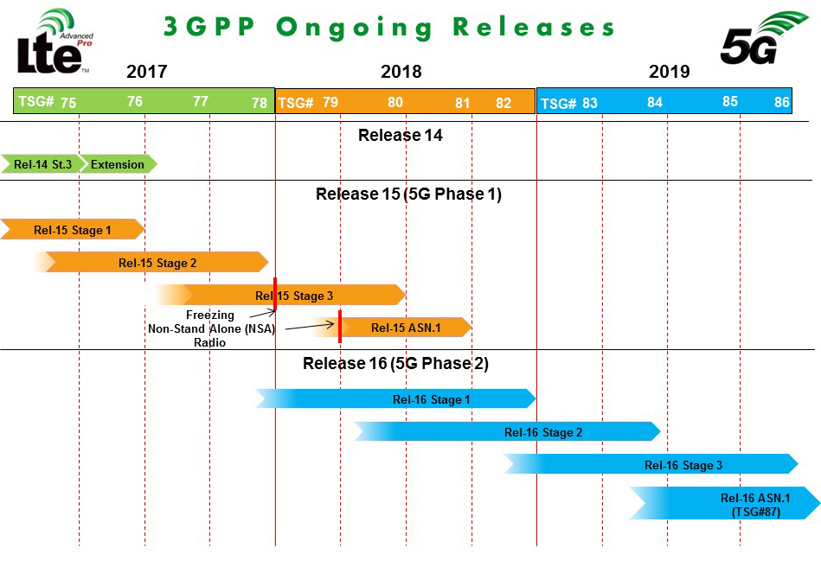
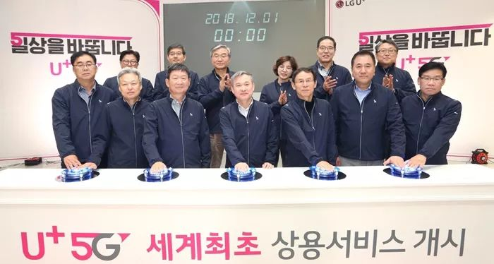
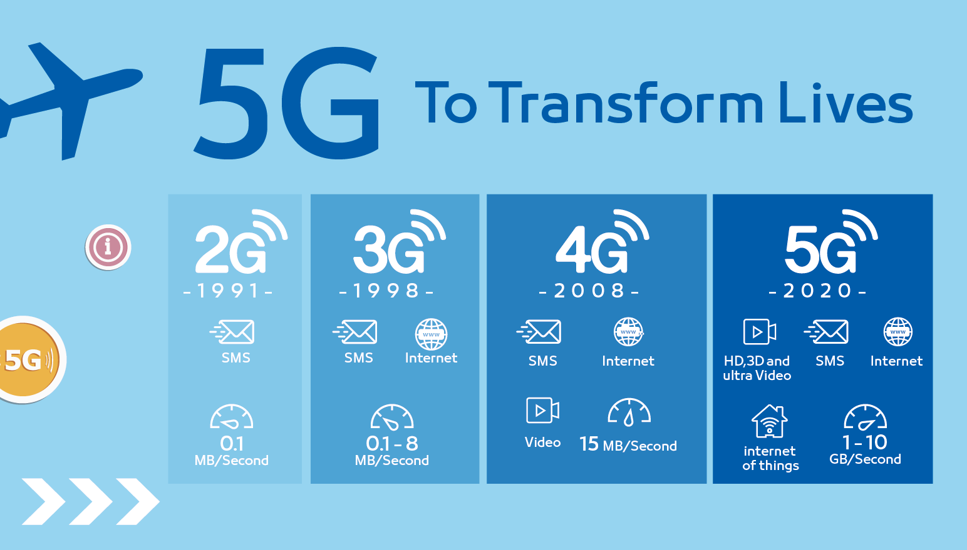
Introduction
5G era is coming

Slide 4
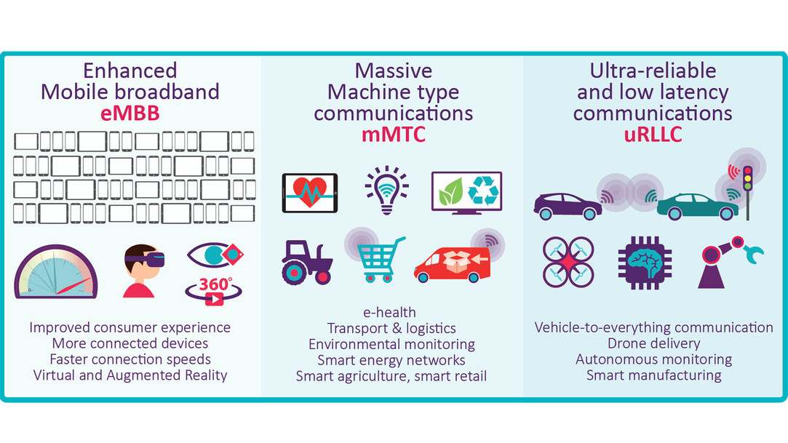
Introduction
3 Big Scenarios

Slide 5
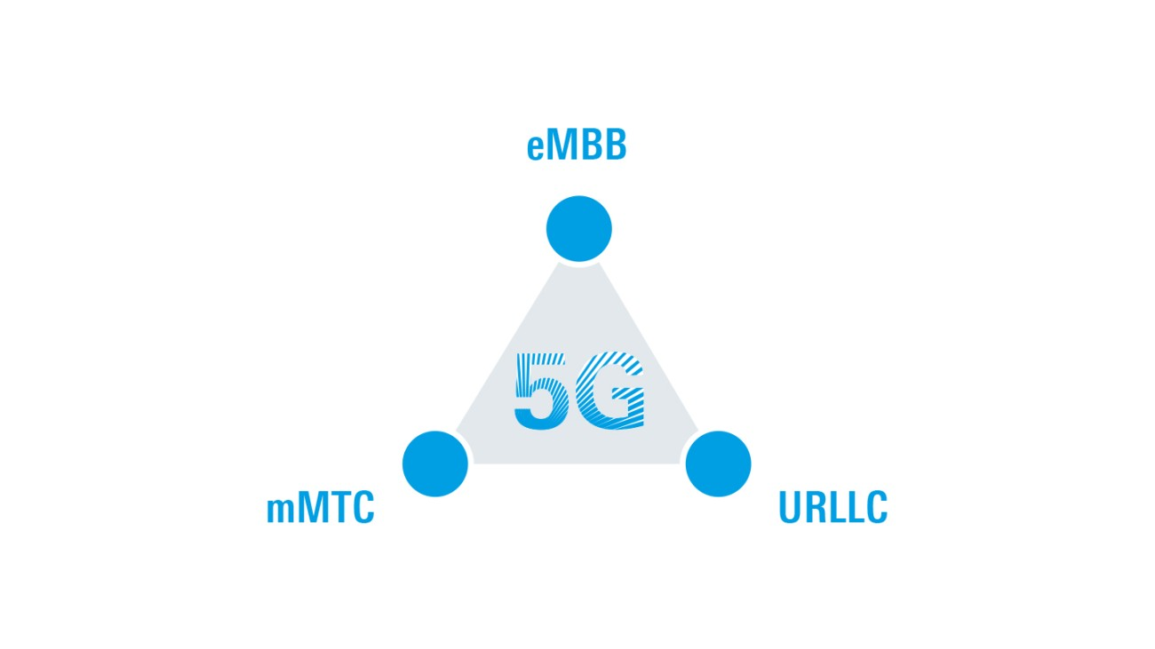
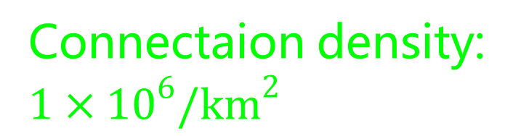
Introduction
Our Focus
Peak data rate:
20Gbit/s
High Speed,
High Capacity
Ultra-low latency and ultra-high reliability
Massive connected devices
Connectaion density:
$$1×{10}^{6}/{km}^{2}$$
Latency: 1ms
Reliability: 99.999%

Slide 6
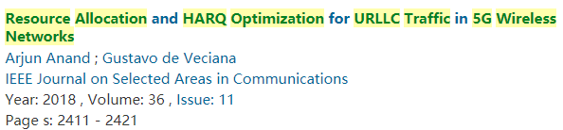
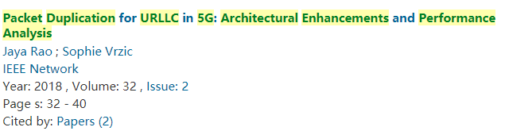
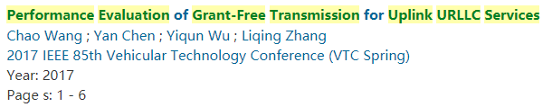
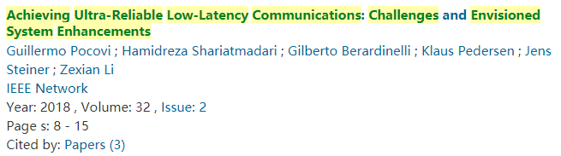
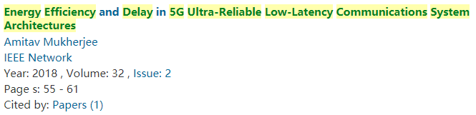
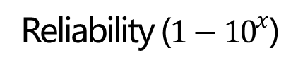
Related Work
To meet the requirements
Reliability ($1−{10}^{x}$)
-3
Grant-free
Low
Latency
-4
Short TTI
-5
Edge Caching
URLLC
Ultra Reliability
Latency (ms)
0.1
1
10
100
HARQ
Packet Duplication

Slide 7
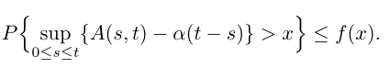
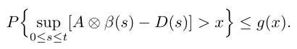
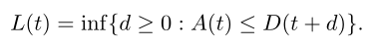
System Model
Stochastic Network Calculus
Definition 1 (Stochastic Arrival Curve).
A(t) ∼< f,α >
Data
Arrival curve
α(t)
Definition 2 (Stochastic Service Curve).
S(t) ∼< g, β >
Service curve
β(t)
Definition 3 (Latency Process).
Latency
Time

Slide 8




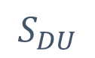


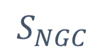

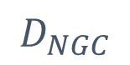
System Model
5G URLLC Architecture
$$A_{AUU}$$
$$D_{DU}$$
$$D_{CU}$$
$$D_{NGC}$$
$$D_{Cloud}$$
UE
$$S_{AUU}$$
$$S_{DU}$$
$$S_{CU}$$
$$S_{NGC}$$
$$S_{Cloud}$$

Slide 9

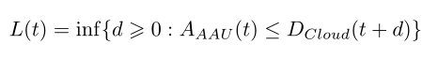
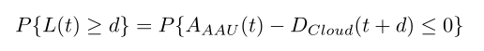
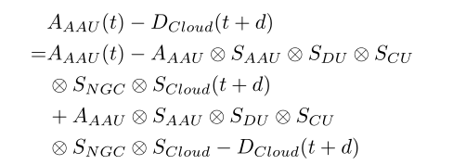
System Model
Latency Bound of URLLC
Data
Arrival curve
α(t)
Service curve
β(t)
Latency
Time
Definition 3 (Latency Process).

Slide 10
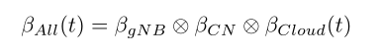
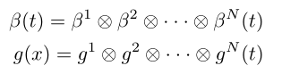
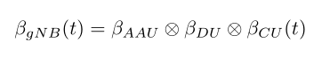
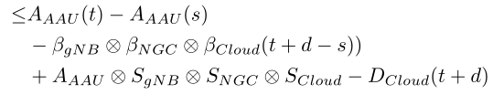
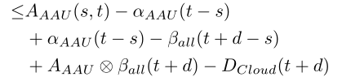
System Model
Latency Bound of URLLC
Concatenation Property
Considering a flow passes through
a network of N server nodes in tandem. If each server nodes n(= 1,2,...,N)
provides a stochastic service curve Sn∼< gn,βn> to its input, then the
network guarantees to the flow a stochastic service curve S ∼< g,β > with

Slide 11
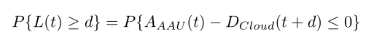
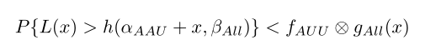
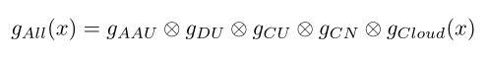
System Model
Latency Bound of URLLC
Definition 1 (Stochastic Arrival Curve).
A(t) ∼< f,α >
Definition 2 (Stochastic Service Curve).
S(t) ∼< g, β >
For long-term running, if t → ∞,
αAAU(t −s) − βAll(t + d − s)
approximate to zero

Slide 12
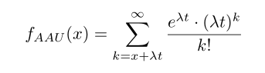
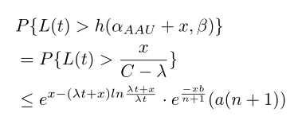
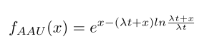
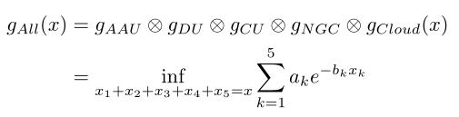
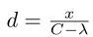
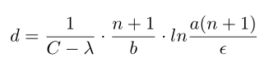
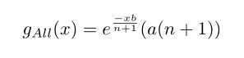
System Model
Compute the Latency Bound
Probability bound function:
To compute the latency d:

Slide 13
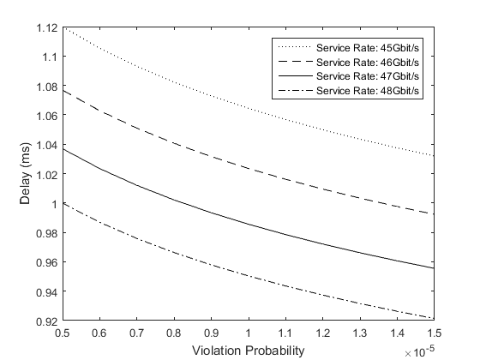
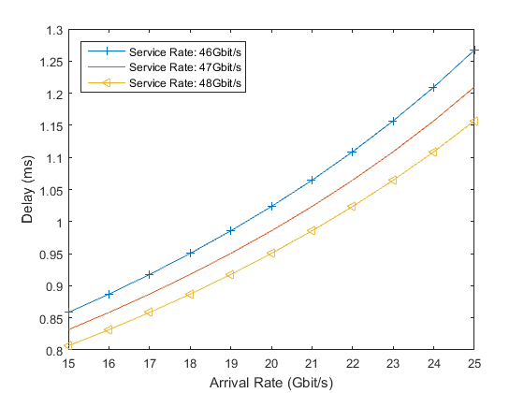
Performance Evaluation
Delay Analysis

Slide 14
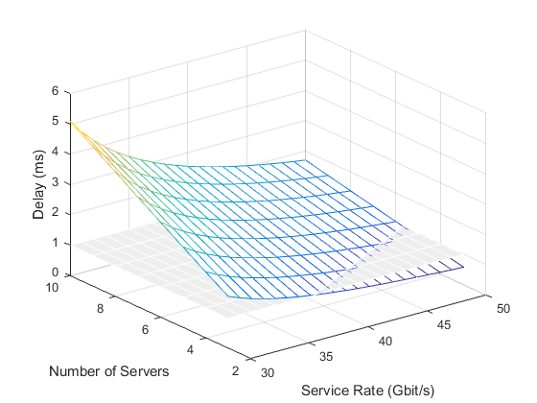
Performance Evaluation
Delay Analysis
Number of
Tandem Servers
Arrival Rate
Delay
Service Rate
Violation Probability

Slide 15
Conclusion
Main contributions
Analysis
Model
Achievement
We build a tandem model to simulate 5G network architecture from UE to cloud server.
For delay analysis, stochastic latency bound for URLLC network is
obtained.
Based on our analysis results, we can find out what parameters are the
key factors affecting the delay

Slide 16
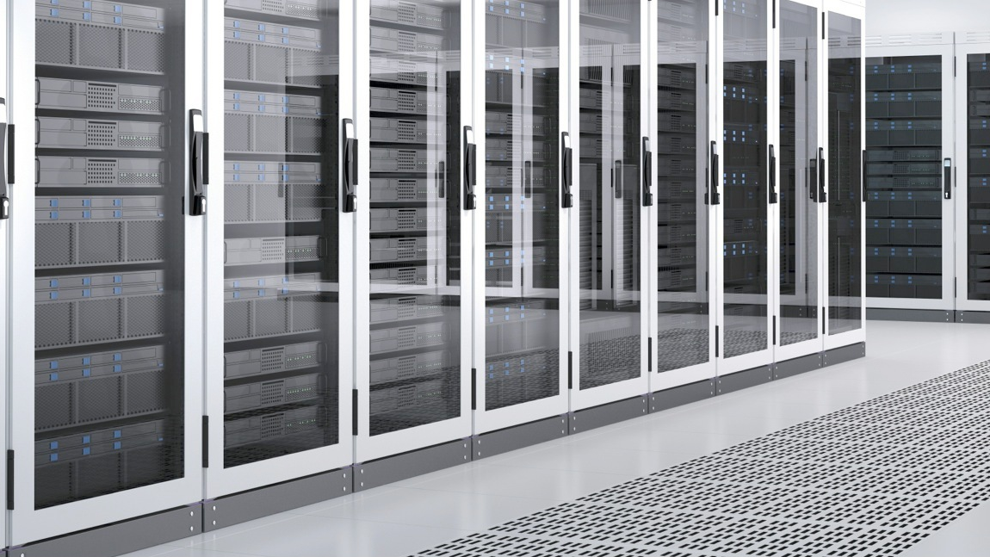
Thank You!
Notes:
In this slide there is a background placeholder. Click to the small icon on the center of the slide and choose an image from computer. When add an image, you must sent it to back with Right Click on Image -> Send to Back -> Send to Back.

